Slide 1
Smart fouling prevention with MOL®LIK Catalyst
18th September 2020
Jan Koppe - MOL Katalysatortechnik GmbH

Slide 2
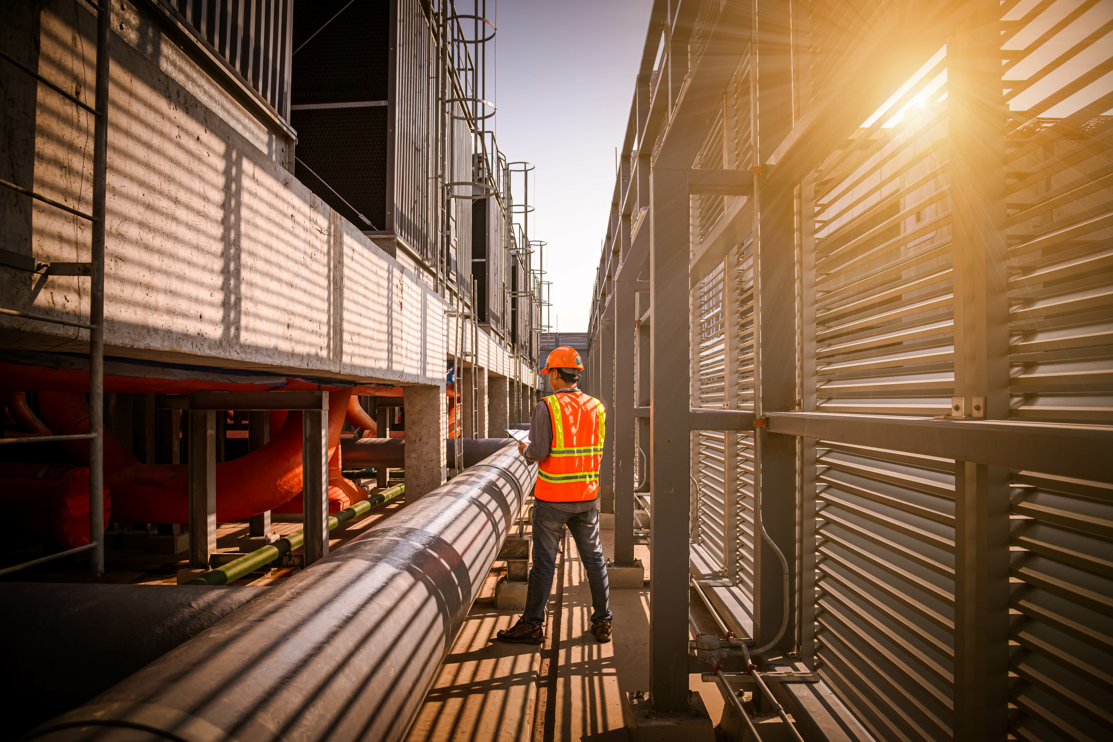
Agenda
Catalytic water treatment – What is possible?
Implementing a MOL®System
Ideas for Common Project Follow-up
Projects objective: Ensuring a compliant cooling water operation with moderate maintenance efforts.

Slide 3
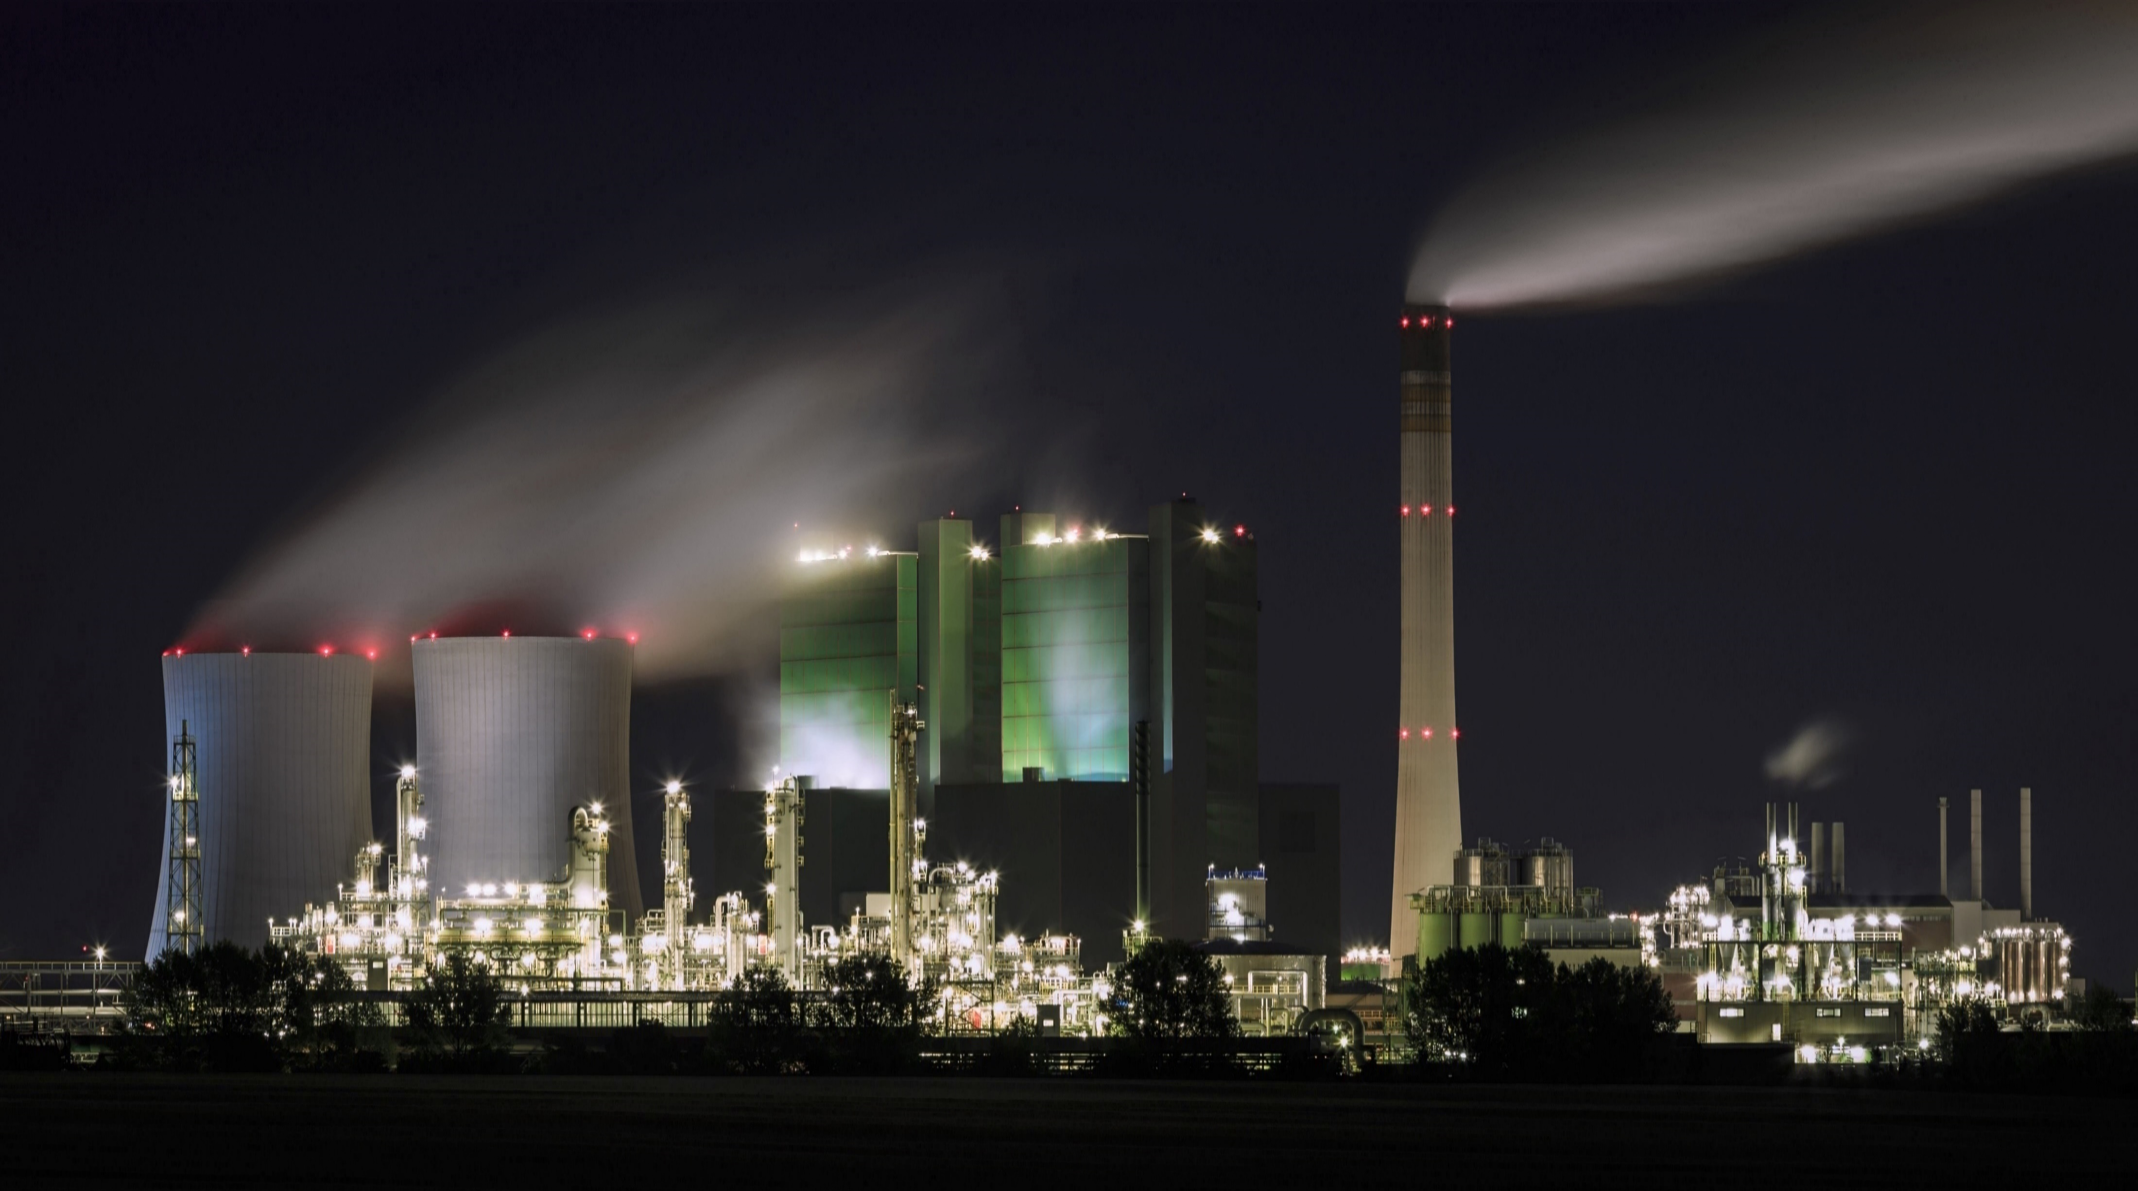
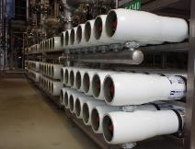
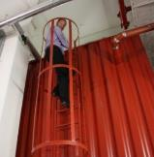
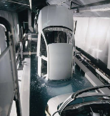
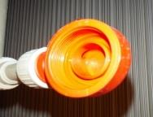
Assessment from the Federal Institute for Occupational Safety and Health (BaUA) from 3rd March 2017:
„[…] das MOL®LIK-Verfahren in der … beschriebenen Wirkweise und Bestimmung [unterfällt] nicht der Biozid-Verordnung (EU) Nr. 528/2012) […]“
Translation: The MOL®LIK-technology with the described principle of working is not subject to the European Biocides Regulation Nr. 528/2012
Cooling circuits
Membrane- Systems
Storage- Tanks
Process-Water
HVAC
One technology – so many possibilities!

Slide 4
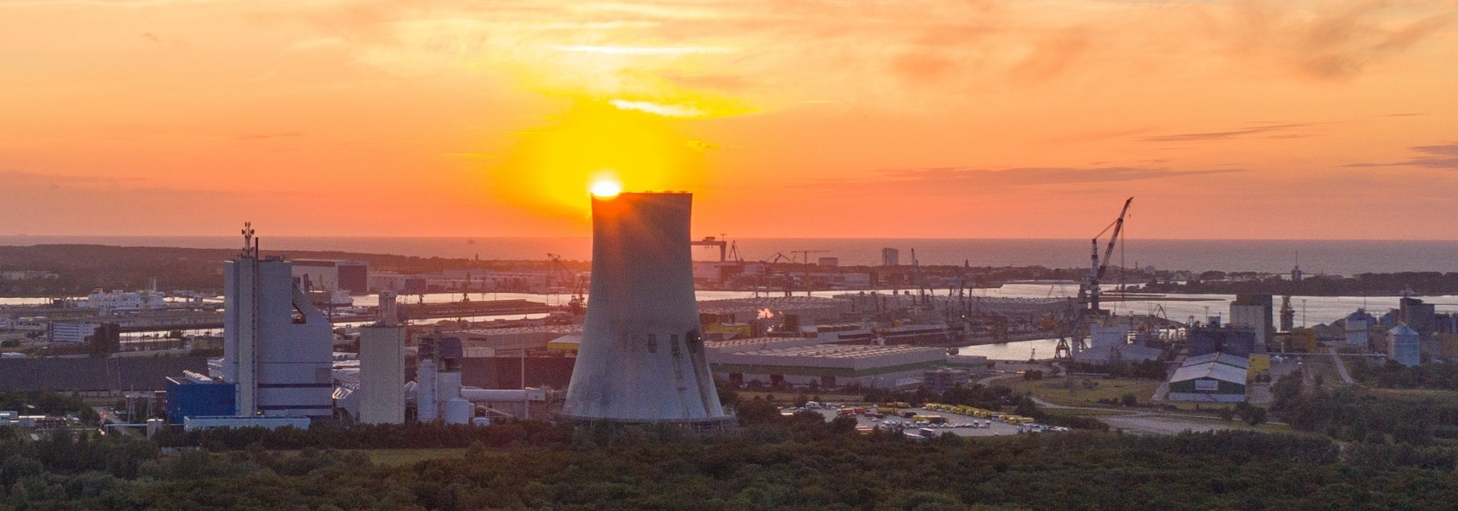
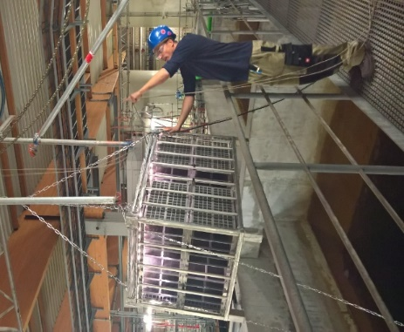
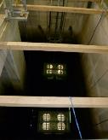
What is possible?
Coal Power Plant Rostock/Warnemünde - Germany
Everything within the guidelines
Stable cooling water quality
None biocides required
Improved COC
Usage of blow down as energy surce
Customers Benefit
Evaporation 1000 m³/h
1 500 m³/h
⬅ 8 km ➔
~ 50 000 m³/h
V: 20 000 m³

Slide 5
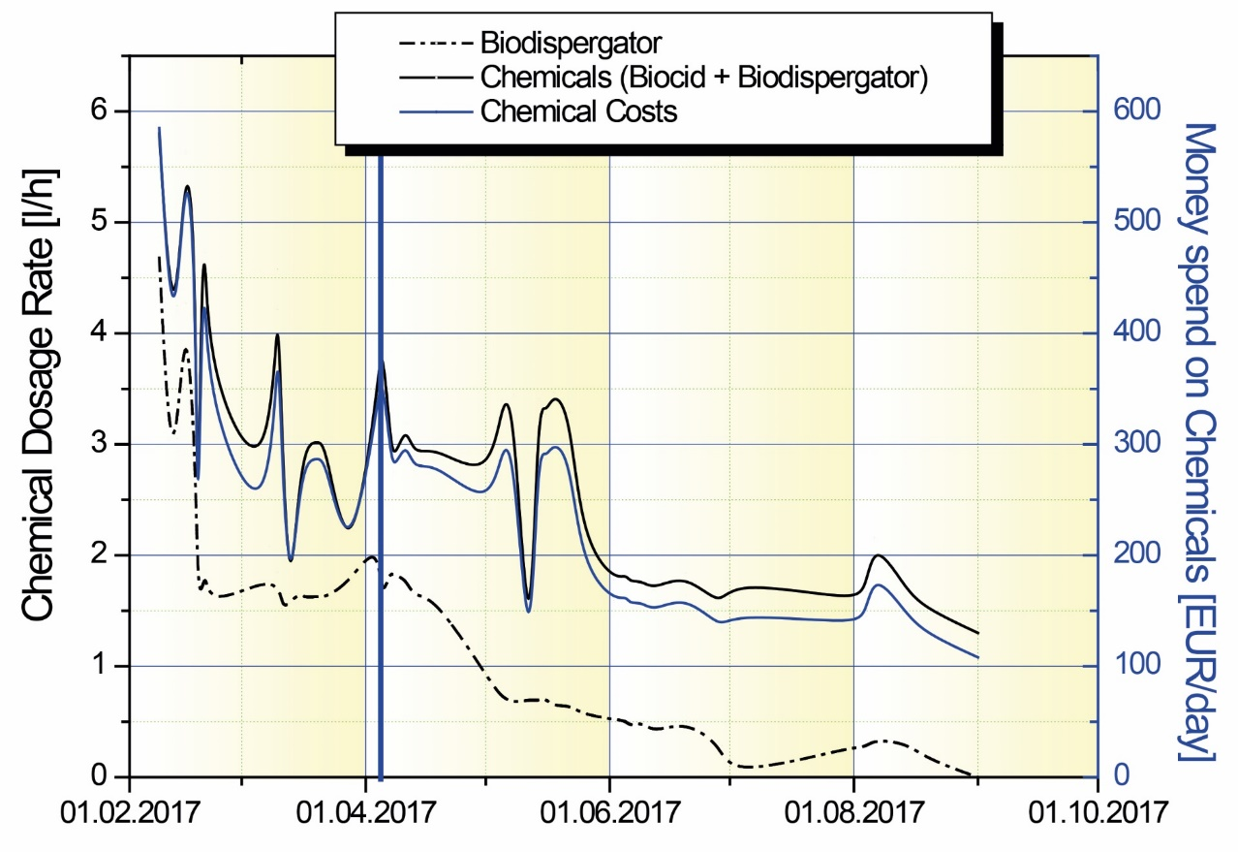
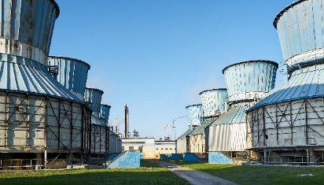
Development of Chemicals at 25 MW Cooling Tower What is happen with chemicals efficiency?
Make-up: Condensate from sugar production
25 MW Cooling Tower | Conventional | MOL®LIK Project
Total money spend at chemicals | 200 till 600 EUR/day | Step by step Reduced to 100 EUR/day
 | Feb - March (59 days) 21000 EUR | April -14th September (167 days) 28500 EUR
Money saved at chemicals | 0.00 EUR | > 31 000 EUR
MOLLIK retofit
Based on: Water Structures & Membrane Systems Koppe, J. & Battagello, G. // 2nd International MerWaterDays 2017
Customers Benefit
Better ∆T (~1.2 K) Improved chemicals efficiency
…MOL®LIK projects are optimizing the chemical demand

Slide 6
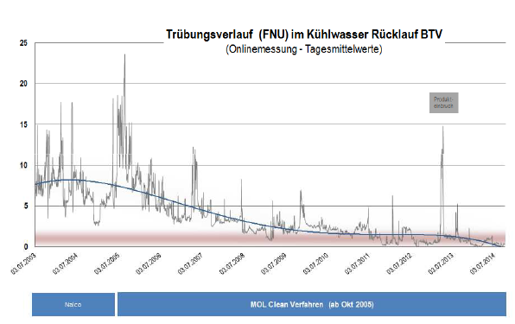
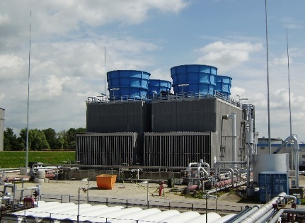
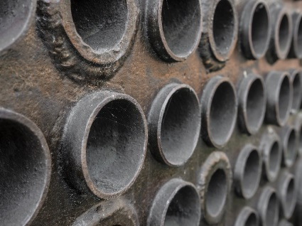
Development of Turbidity at refinery cooling water
Refinery cooling circuit with 3500 m³/h of surface water
25
20
Turbidity (FNU)
15
Based on: BAYERNOIL Journal 04/2014 – p 23
10
Customers Benefit
Stable perfromance
Less cleaning & chemicals Satisfy legal obligations
5
0
2004
2005
2006
2007
2008
2009
2010
2011
2012
2013
2014
conventional
MOL®treated (since IV/2005)

Slide 7
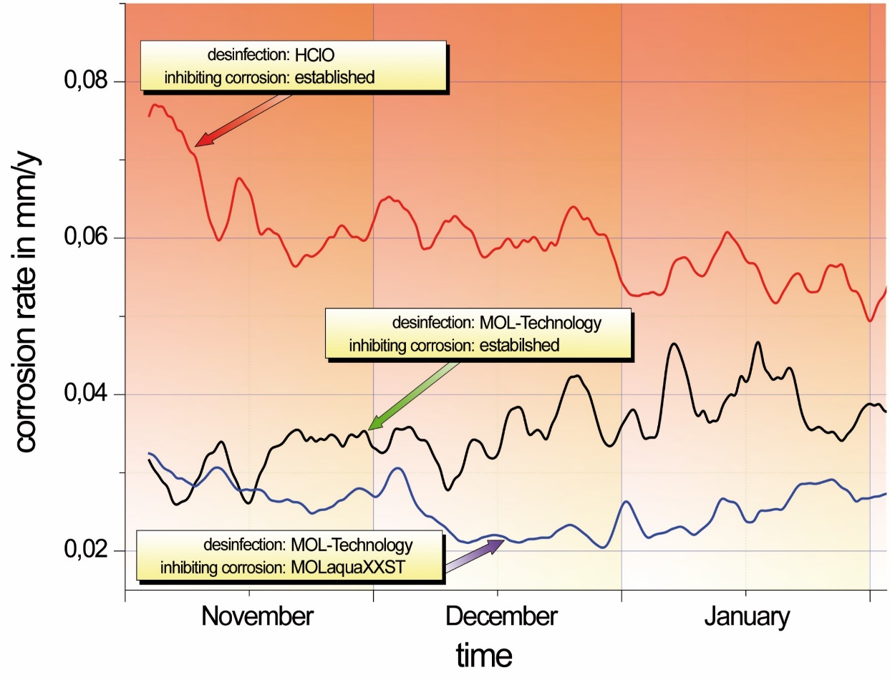
Development of Corrosion rate at cooling water
Lukoil
Bayernoil
Gaspromneft
Natural-draft cooling towers
CLARIANT
HClO + conventional corrosion inhibition
MOL + conventional corrosion inhibition
Based on: Passivschichten - wlb – September 2009 MOL Katalysatortechnik GmbH & PCK Raffinerie GmbH
All Russian projects supported by
MOL + optimized corrosion inhibition
Minimizing Deposits ➔ Less Troubles with Corrosion

Slide 8
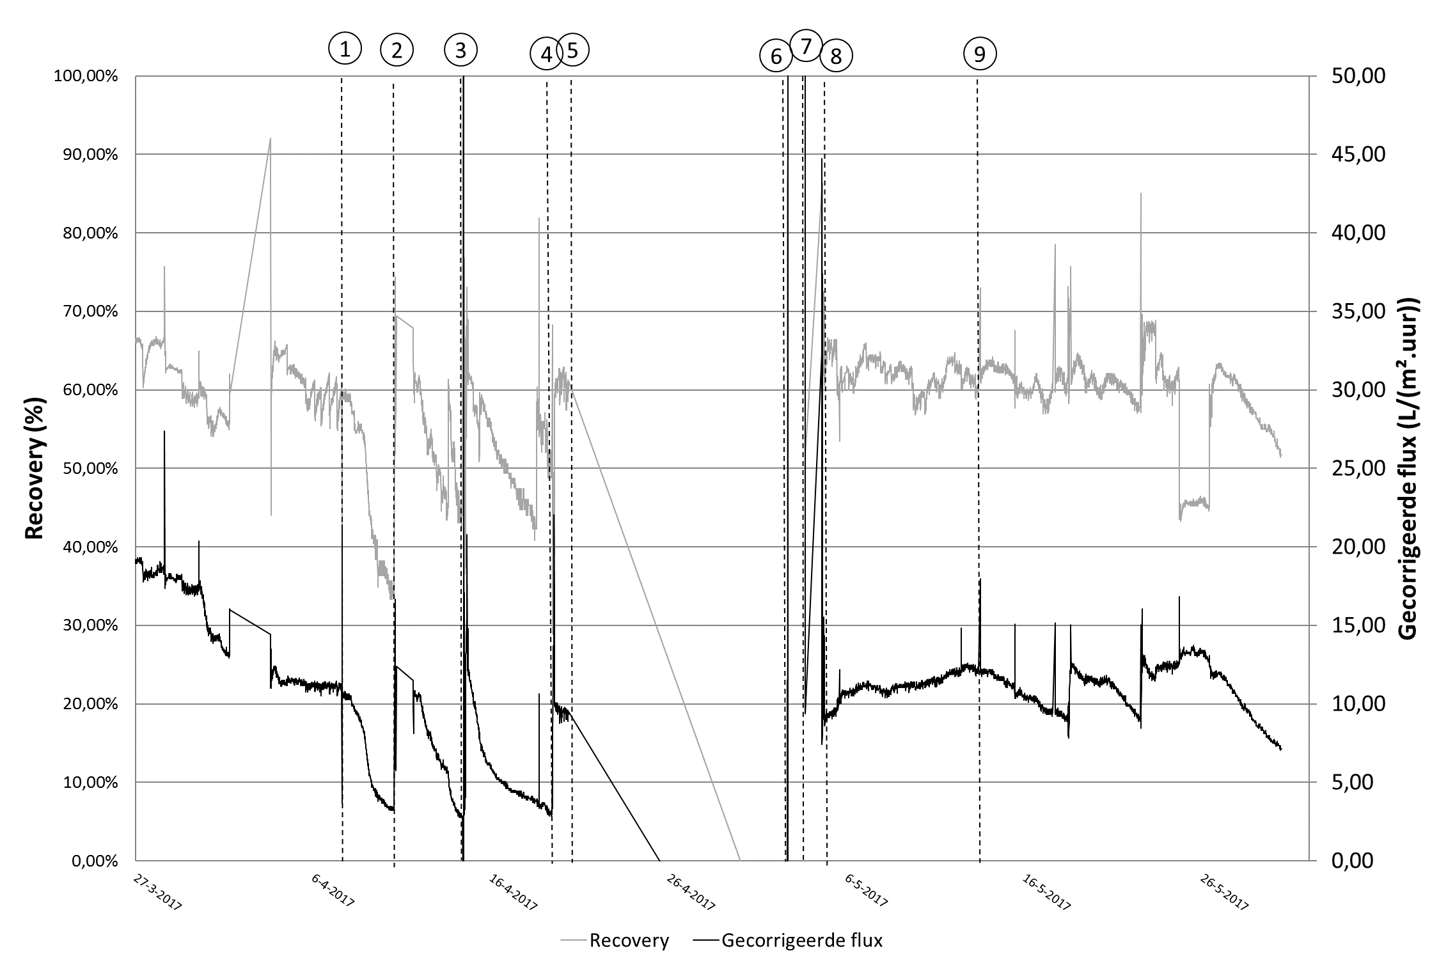
Water reuse – Catalytic benefit @ Membranes
conventional
catalysed (MOL®LIK)
100
50
80
40
60
30
Normalized Flux [l/m²*h]
Recovery [ %]
Based on: Reyniers, S.; Depuydt, V.: Chemicaliënvrije Afvalwater Recuperatie in de VoEdingsindustrie – CARVE Projekt Meeting - Tussentijdse meeting; 23th June 2017;
40
20
Customers Benefit
20
10
Increased flow Reduced CIP
0
0
27-3-2017
06-4-2017
16-4-2017
26-4-2017
06-5-2017
16-5-2017
26-5-2017

Slide 9
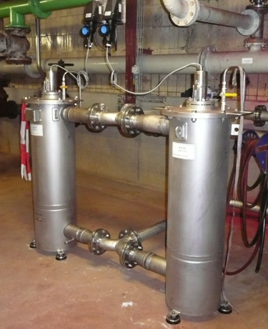
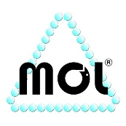
Membrane Systems @ Surface Water
1µ Filter
RO-Prefilters @ INESCO plant in Antwerp/Belgium
 | Conventional | MOL®LIK
Average Flow Rate | 40 m³/h till 90 m³/h | 65 m³/h till 100 m³/h
Average difference pressure | 0.1 till 0.3 bar | 0.05 till 0.1 bar
CIP-Intervall | 2 till 3 days | 30 days
WTU Inesco
Performance of filters in challenging area with different strategies

Slide 10
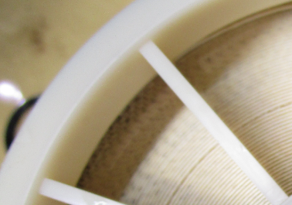
Membrane Systems @ Surface Water
MOL®LIK-Effect on Membranes Performance of INESCO plant in Antwerp/Belgium
Rising efficiency of chemicals
No biofouling on RO membranes
Continously flow rate of 120 m³/h
Reducing CIP more than 50 %
Increasing membrane life time
WTU Inesco
CAPEX: 60 000 EUR OPEX: 7 000 EUR

Slide 11
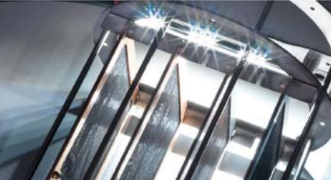
Financial Facts
Kind of System | Details | CAPEX | OPEX
Power Plant | Make-up: 1 500 m³/h // Cooling Capacity: 600 MW Make-up Quality: Sea Water Circulation rate: ~ 50 000 m³/h Volume: 20 000 m³ // COC: 2.0 till 3.0 | 110 000 EUR | 7 000 EUR/Year
Cell Cooling Tower | Make-up: 70 m³/h // Cooling Capacity: 25 MW Make-up Quality: Condenstate (from sugar production) combined with decarbonized water Circulation rate: ~ 2 500 m³/h Volume: 320 m³ // COC: ~ 5.0 | 110 000 EUR | 3 000 EUR/Year
RO | Make-up: 4 m³/day // Quality: MBR-Water | 500 EUR | 100 EUR/Year
RO | Make-up: 250 till 450 m³/h // Quality: Surface-Water Permeate-Capacity: 3 x 120 m³/h | 60 000 EUR | 7 000 EUR/Year
Life time of the MOL®LIK catalyst: 10 years

Slide 12
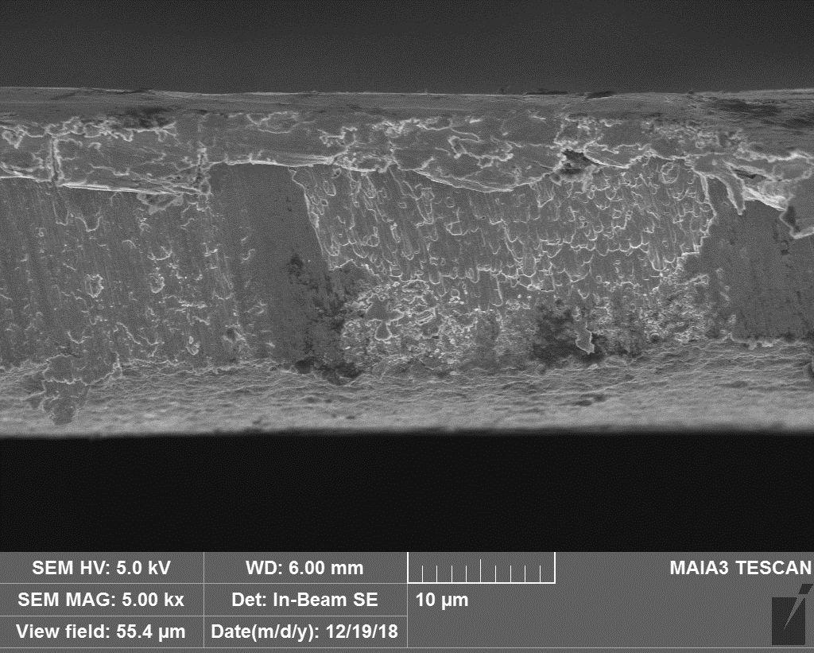
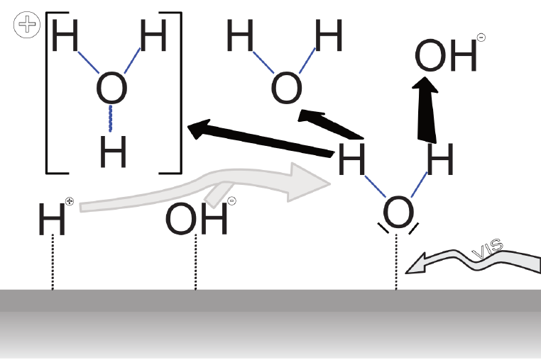
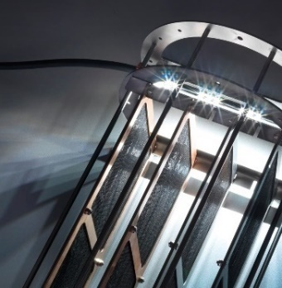
Water & Catalysis – the tool for small gas bubbles
The catalyst – a mineral metal combination
Professor Dr. Su Benshueng Engineering Research Institute Beijing University of Chemical Technology
Notes:
leistung

Slide 13
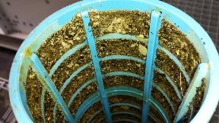
Implementing a MOL®System
Cleaning before MOL®LIK | Not cleaning before MOL®LIK
Stays clean from day 1 | Takes longer
 | A risk of blocked filters
 | Filters exchanged more frequently
Source: E. Mazo Bedia
We recommend a conventional cleaning of your system before installing MOL®LIK!

Slide 14
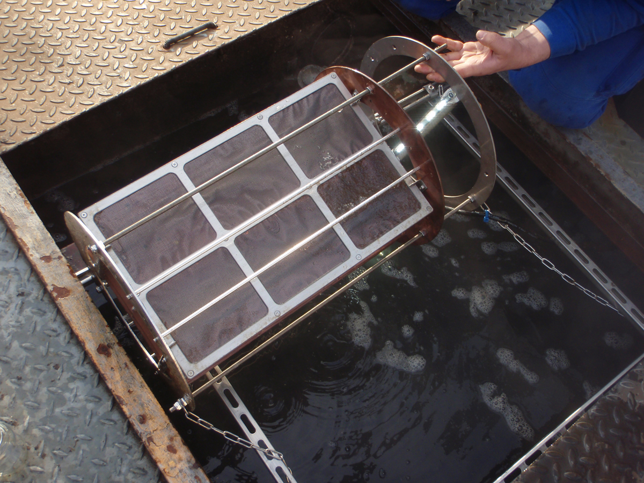
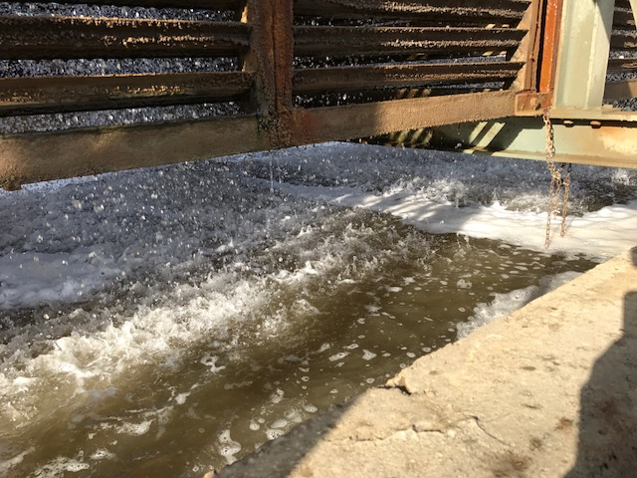
Installation
The catalyst should be covered by a sufficient water level
The water should not flow against the catalyst foils, but through the openings
Please follow also the instructions contained in the user manuals
Question: Is the power connection prepared? (IP 54 /10 A/ 100-240 V AC within 2.5m)

Slide 15
Maintenance & Service
Parameter | Recommended Interval | Target value/target condition
Check of the equipment | Weekly | Check of the water level and led-module The MOL®LIK-catalyst must be completely covered by water.
Control the circulating water for detached deposits. | Every 2 till 6 weeks | Detached deposits should be removed from the circulating water Therefore, partially replace the water.
Check of the MOL®LIK unit for possible deposits. | Every 2 till 6 weeks | Such deposits can reduce the MOL®LIK-effect. Remove these deposits gently (e.g. with a soft brush & slight water flow)
Functional check by an authorized service technician. | Annually
Question: Who will take care of maintenance?

Slide 16
Chemicals | Demand
 | kg/h | kg/a
SUEZ SPECTRUS OX1272 [Biocide] NaOCl + NaOH
SUEZ DEPOSITROL BL6502 [Deposit control agent] C2H4Na4O7P2 Phosphonic acid, (1-hydroxyethylidene)bis-, sodium salt
STP polymer [Stress Tolerant Polymer]
Anything more???
Data of technical situation at selected application
→Targets:
1. Reducing the issues with deposits
2. Optimisation chemical demand
→With MOL®LIK:
Reduction of biocides
Rising efficiency of hardness stabilizers & corrosion inhibitors
Question: Are there any information on current chemical dosing situation?

Slide 17
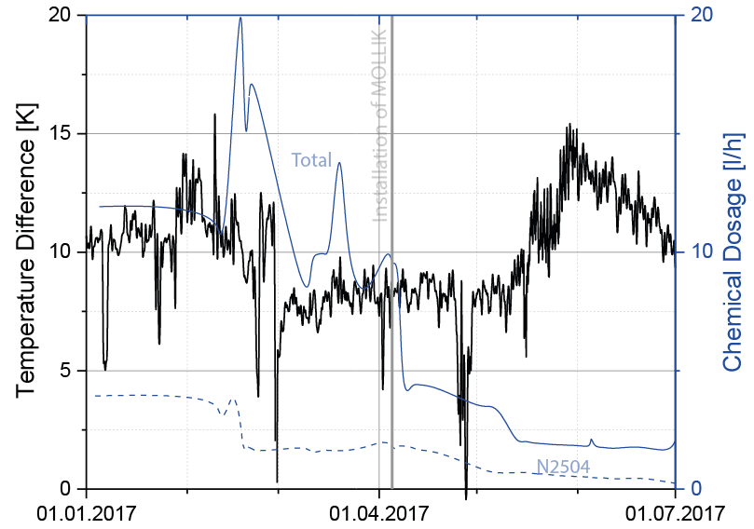
Development of Chemicals – what is possible with MOL®LIK What is happen by excess chemical dosage – further effects?
 | conventional | MOL®LIK Project
Average N2504 | 1.7 l/h 18th Feb. until 4st April | 0.42 l/h 5th June until 1st July (last value 0.2 l/h)
 | 75 % reduction
Average N8514+ | 10.8 l/h 18th Feb. until 4st April | 1.4 l/h 5th June until 1st July (last value 1.5 l/h)
 | 85 % reduction
…Optimization @ chemical dosage ➔ improving cooling perfromance

Slide 18
Ideas of common project Follow-up:
Make-up & Cooling Water (every two weeks)
LSI / COC / Conductivity / Calcium Retention of cooling water
Iron / Copper / Turbidity (only in case of troubles) of cooling water
Detailed history of so far used products (What? How much? How often?)
Cooling tower
Microbiological condition (Legionella)
Circulation pump performance and temperature trend
Date of last cleaning & approximate cleaning frequence with required efforts
Photographic documentation
Heat exchangers
Flow and temperature trend
k-values
Maintenance procedure
Backwash properties/ Differential pressure of filters in cooling circuit
Selected data are also required for the time frame before the installation of MOL®LIK, with continuous sending to MOLKAT during the project

Slide 19
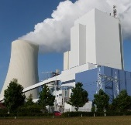
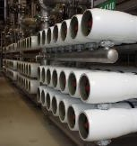
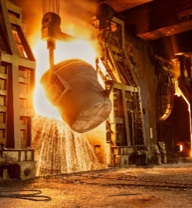
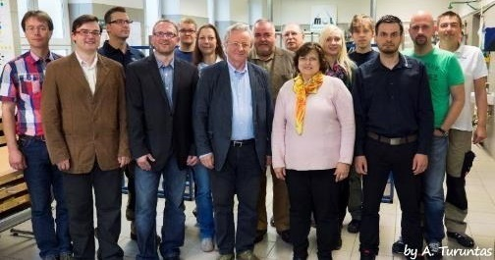
Thanks on your attention

Slide 20
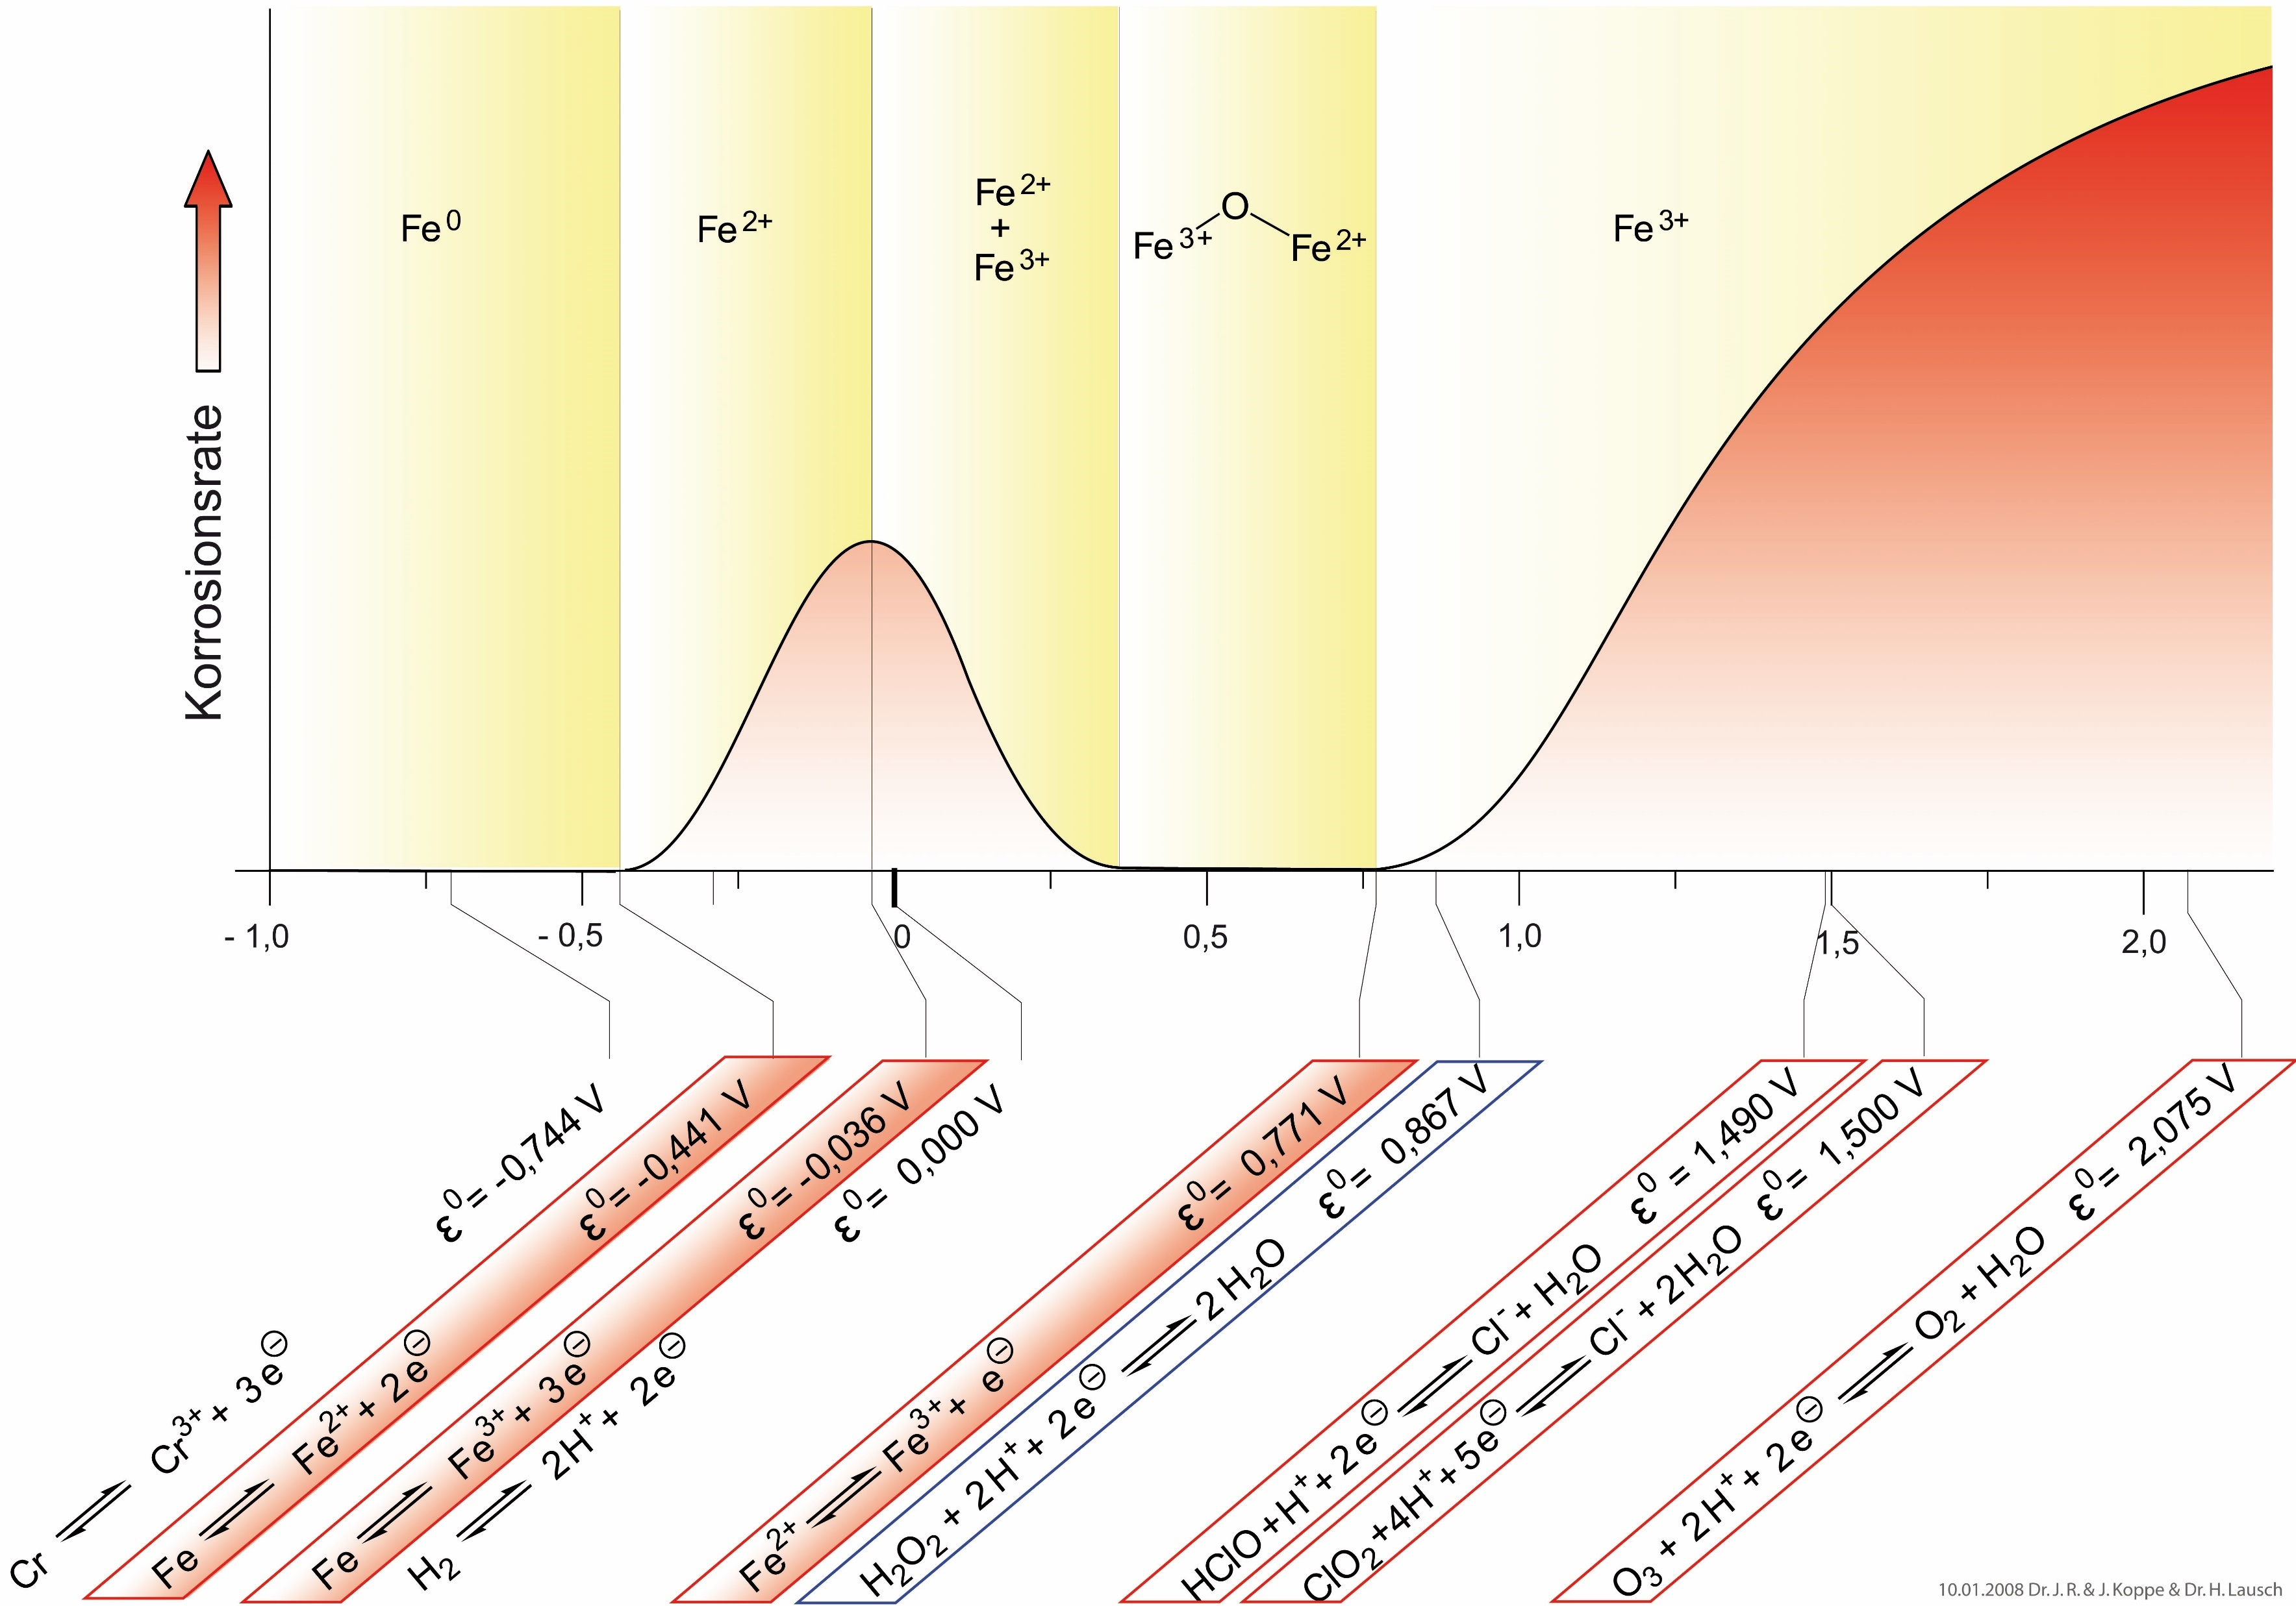
Korrosion & Wasser

Slide 21
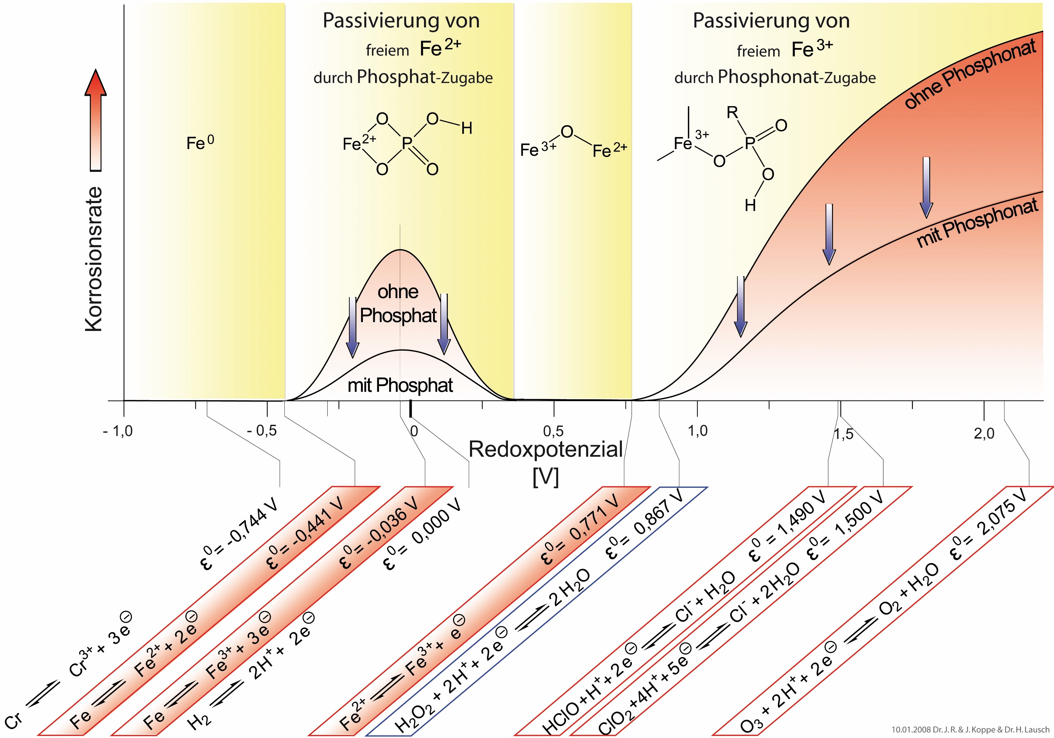
Korrosion & Wasser

