Slide 1
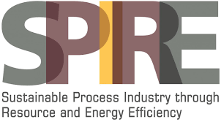
Ensuring Safe Operation by Sustainable Water Treatment
Yves Peeters – MARITECH
Jan Koppe – MOL Katalysatortechnik

Slide 2
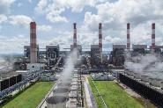
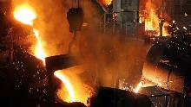
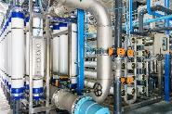
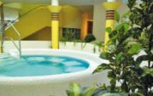
MOLKAT – The Core business
Improved Heat Transfer
Rising Filter Performance
Common Goal:
Minimzing
MTBF
Achieved Through:
  Deposits minimization
  Corrosion avoidance
  Hygienic control

Slide 3
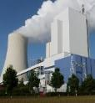
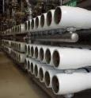
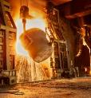
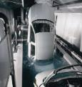
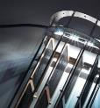


MOLKAT – Sustainable Water Management
Customers Benefit
Ensuring Safe Operation
+
50 – 90 %
80 %
5 – 20 %
Reducing
chemical dosage
Minimizing
Maintenance
efforts
Optimizing
Energy demand

Slide 4
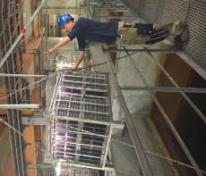
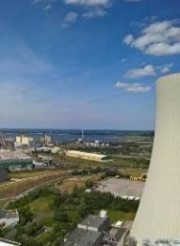
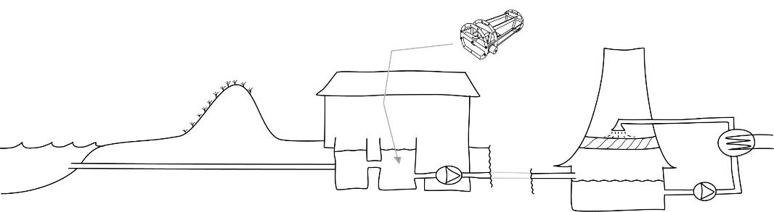
Water Supply – How to handle Challenges
sustainable solution:
➔ Installation of suitable
catalyst module
Evaporation
1,000 m³/h
Make-up
1,500 m³/h
~ 50,000 m³/h
V: 20,000 m³
⬅ 8 km ➔

Slide 5
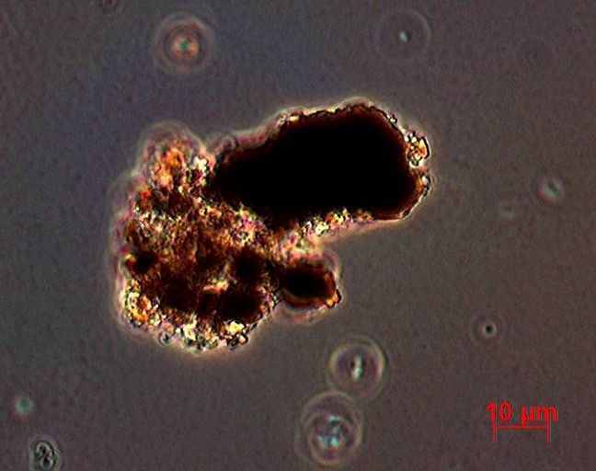
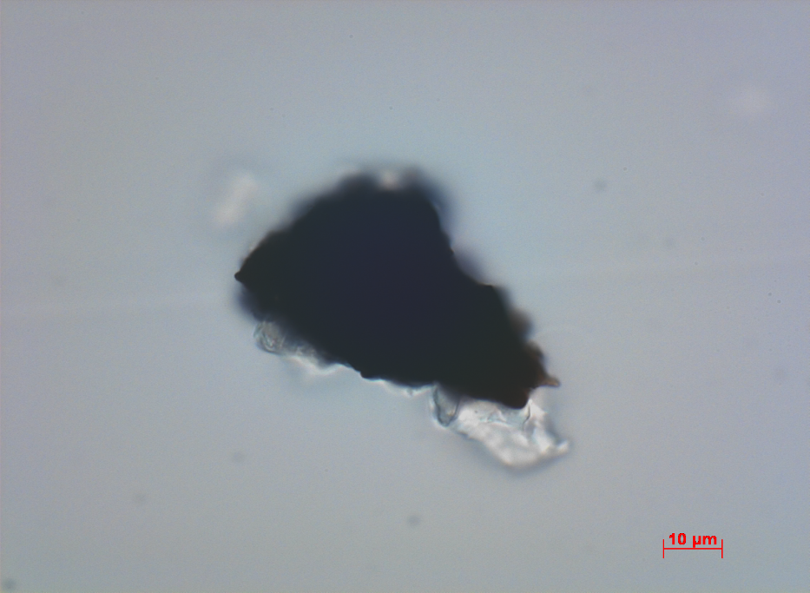
Active carbon
Conventional operational mode
With catalytic water treatment
Various organic & inorganic deposits
Some inorganic deposits

Slide 6
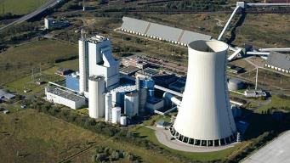

Water Supply – How to handle Challenges
Removing deposits
  Minimizing turbidity
    No microbiological troubles (Legionella < 10 CFU/100 ml)
        Biocide free operation
          Use of blow down as a heat source
          (@ fertilizer industry)

Slide 7
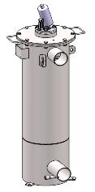
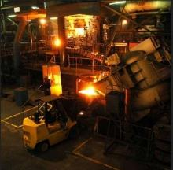

Water Supply – How to handle Challenges
Case II: Foundry with river water & deposits troubles in Ieper/Belgium
Benefits of water pre-treatment optimization (MOL®LIK vessel @bypass installation):
  No deposits on melting furnace
    No additional sandblasting or other mechanical cleaning
      Cleaned cooling towers
        Cleaned heat exchangers
          Increased production volume
Based on:
How Can MOL®LIK Help against Water Stress?
Sanczuk, T. // 3rd International MerWaterDays 2018

Slide 8
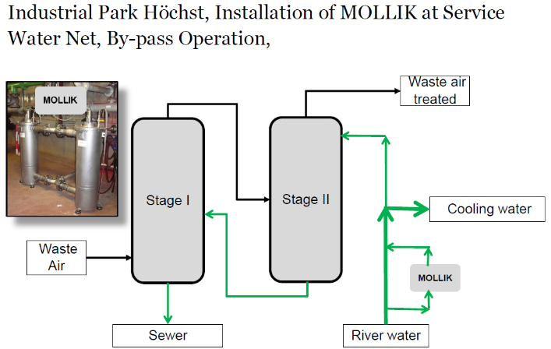
Water Supply – How to handle Challenges
Case III:
Based on:
COST CUTTING WITH EFFICIENT TECHNOLOGIES AT INDUSTRIAL WATER SUPPLY, PRACTICAL EXPERIENCE WITH MOLLIK AT CHEMICAL PRODUCTION // Zorn , F.// 1^{rst}International MerWaterDays 2016

Slide 9
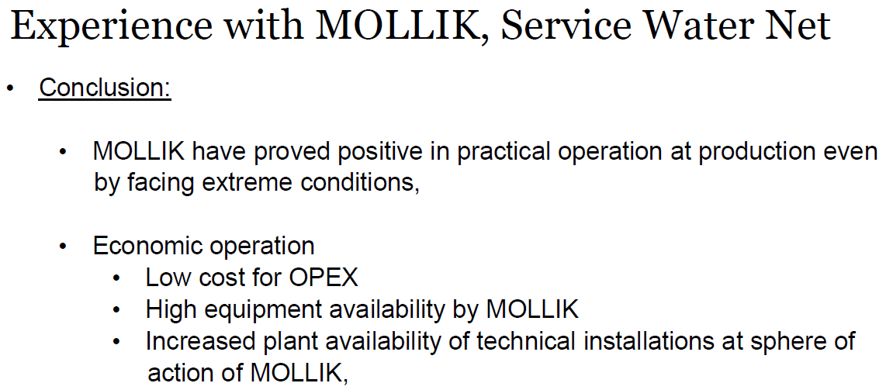
Water Supply – How to handle Challenges
Case III:
Based on:
COST CUTTING WITH EFFICIENT TECHNOLOGIES AT INDUSTRIAL WATER SUPPLY, PRACTICAL EXPERIENCE WITH MOLLIK AT CHEMICAL PRODUCTION // Zorn , F.// 1^{rst}International MerWaterDays 2016

Slide 10
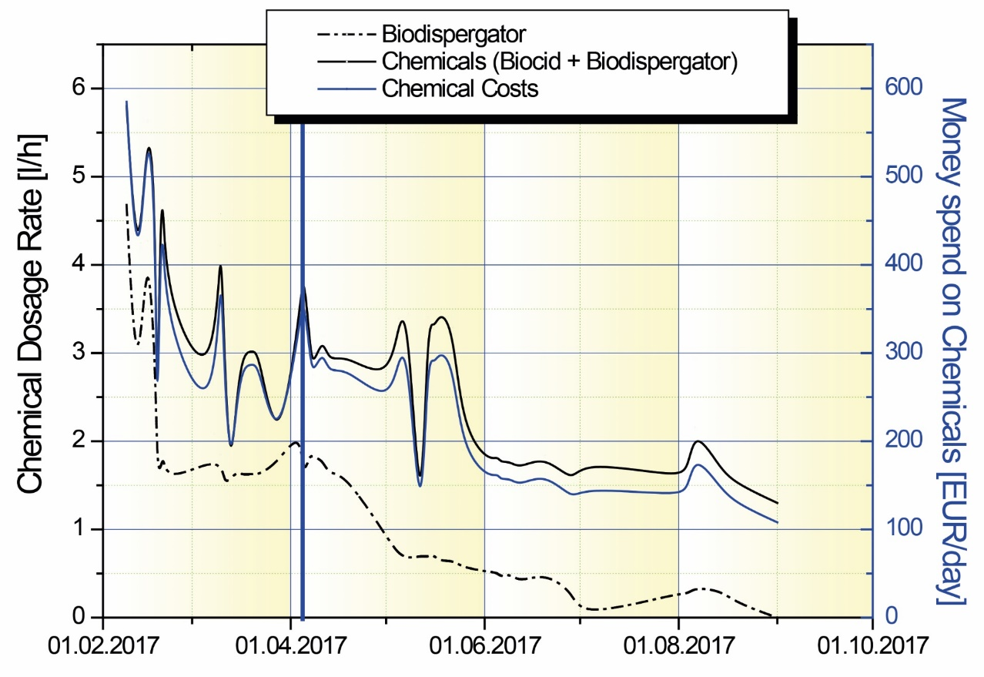
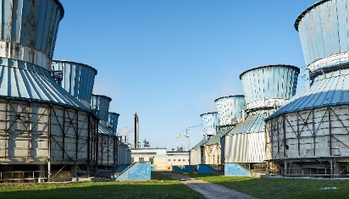
Entwicklung des Chemikalienbedarfs eines 25 MW Kühlturms
Steigerung der Effizienz von Chemikalien
Make-up: Condensate from sugar production
MOLLIK retofit
25 MW Cooling Tower | Conventional | MOL®LIK Project
Total money spend at chemicals | 200 till 600 EUR/day | Step by step Reduced to 100 EUR/day
Money saved at chemicals | 0.00 EUR | > 31 000 EUR
Based on:
Water Structures & Membrane Systems
Koppe, J. & Battagello, G. // 2nd International MerWaterDays 2017
Customers
Benefit
Better ∆T (~1.2 K)
Improved chemicals efficiency

Slide 11
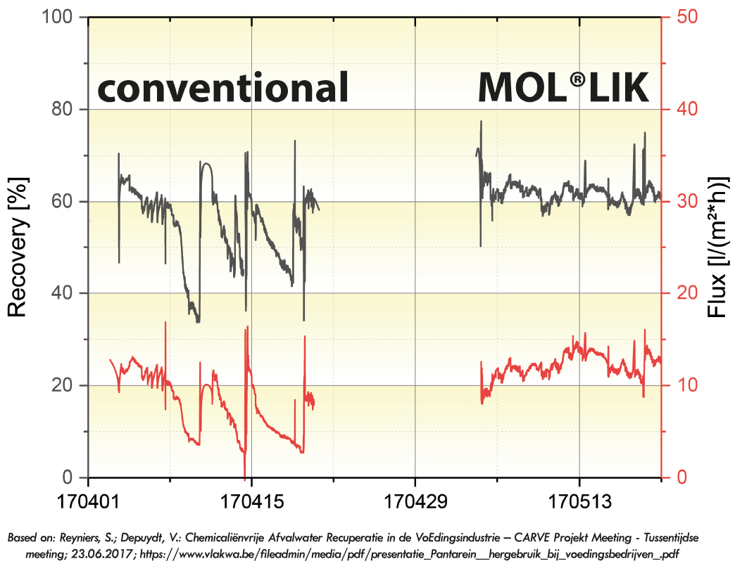

Membrananlagen @ Zero Liquid Discharge
MOL®LIK:
Verbesserung Fluss // Verminderung CIP // Minimaler Druckverlust

Slide 12
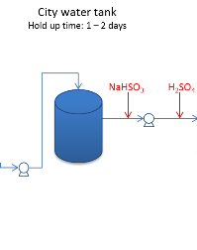
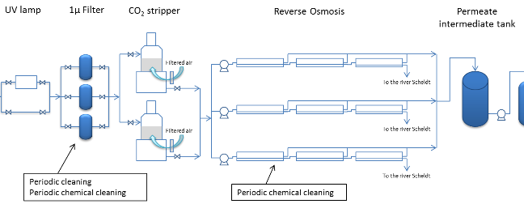
Membrananlagen @ Oberflächenwasser
WTU Inesco
Design capacity per RO:
120 m³/h permeate → decreases to 80 m³/h in short times
4 CIP-cleanings → in 2016: 72 CIP-cleanings in total (22 for RO1/RO3 & 28 for RO2)
Exchange membranes after 5 years of operation → exchange after ~ 2 years
Leistungsbfall einer RO bei konventionellen Behandlungsmethode

Slide 13
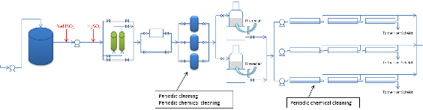



Membrane Systems @ Surface Water
1µ Filter
RO-Prefilters @ INESCO plant in Antwerp/Belgium
WTU Inesco
 | Conventional | MOL®LIK
Average Flow Rate | 40 m³/h till 90 m³/h | 65 m³/h till 100 m³/h
Average difference pressure | 0.1 till 0.3 bar | 0.05 till 0.1 bar
CIP-Intervall | 2 till 3 days | 30 days
Performance of filters in challenging area with different strategies

Slide 14
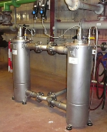
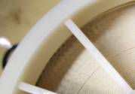
Membrane Systems @ Surface Water
MOL®LIK-Effect on Membranes Performance of INESCO plant in Antwerp/Belgium
Rising efficiency of chemicals
  No biofouling on RO membranes
    Continously flow rate of 120 m³/h
      Reducing CIP more than 50 %
        Increasing membrane life time
WTU Inesco
… Improving YOUR facilities performance with sustainable water treatment

Slide 15
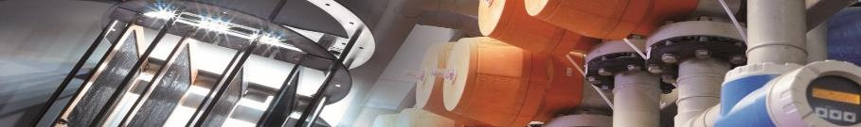






Project Motivation 1: Limitations in water supply is a global issue
Project Motivation 2: Stricter limits by governments
The Way for Waste Water with conventional Treatment Process
Inlet Water
* From different
production Sides
* Higher variability in quality
* High content of hard COD
Neutralization and Flocculation
Primary Clarifier
Secondary Treatment (CAS)
Secondary Clarifier
River
require higher efforts and cost for waste water treatment
www.inspirewater.eu
This project has received funding from the European Union’s Horizon 2020 research and innovation programe under grant agreement No 723702.
Disclaimer notice: The European Commission is neither responsible nor liable for any written content in this poster.

Slide 16

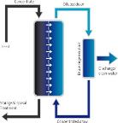

The Solution
Outlet Water
High quality for various
technical applications
MOL®LIK
catalyst
Ultrafiltration (UF)
DOW IntegraFlux™
Reverse Osmosis (RO)
DOW FILMTEC™
Inlet Water
from secondary clarifier
BLUE-tec
FO/HBROTM
INSPIRE WATER
Tap the full potential of industrial waste water!
www.inspirewater.eu
This project has received funding from the European Union’s Horizon 2020 research and innovation programe under grant agreement No 723702.
Disclaimer notice: The European Commission is neither responsible nor liable for any written content in this poster.

Slide 17
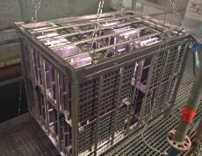

Water – MOL-catalyst – HoW to install?
Option A:
Pressure less Tank
Option B:
Piping Solution

Slide 18
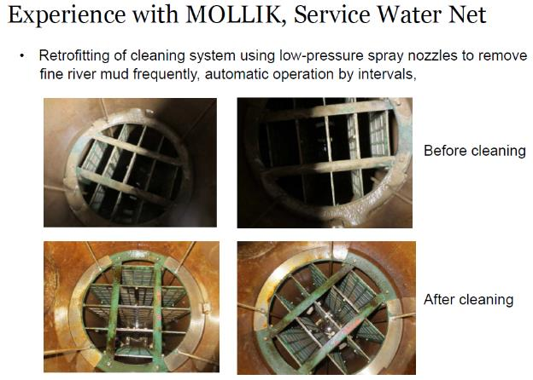
Water – MOL-catalyst – HoW to maintain?
Maintenance Efforts:
  Manual Cleaning
  mostly simple flushing
Life Time:
  Technical life time
  is 10 years

Slide 19
Water – Benefit of Catalytic Water Treament
Catalytic water treatment is
Safe + Economic + Sustainable
YOUR perfect tool for
Ensuring Safe Operation

Slide 20
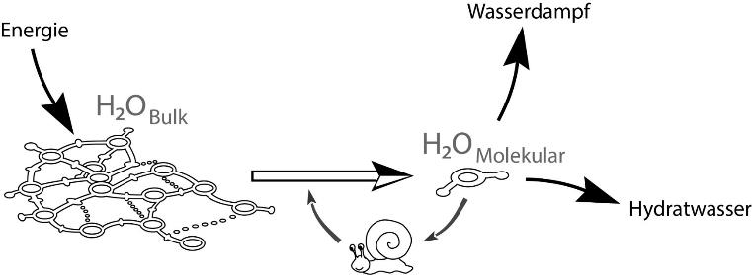

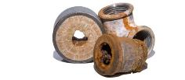
Water – Challanges
Maximum @ process safety – How to ensure?
Priority A: Ensure a sustainable water management
Evaporation
Evaporation = cooling
Hydrate Water
Lack of hydrate water
➔ Scaling & Fouling

Slide 21
Water – Challanges
Available water sources are predestined to contribute productively.
Why is water treatment required?
Anthropogenic water supply systems
…are mostly claiming water unnatural.
Starting with the pumps:
  If pumping capacity (BHP) is above the power of hydrate binding
  ➔ Water from hydrate shells is separated

Slide 22

WATER – How deposits where formed?
+
+
+
Energy intake
higher than osmotic
+ geodetic pressure
If energy intake is higher than power of hydrate binding
➔ unbinding of H₂O_{molecular}
Risks: Hole on hydrate shell ➔ Formation of Deposits
Huger gas bubbles ➔ Cavitation

Slide 23
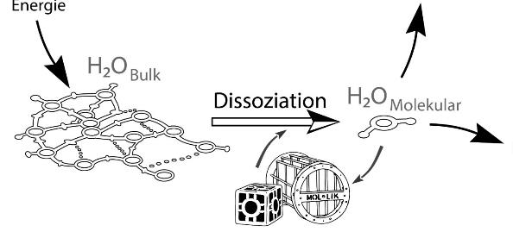
WATER – deposits Fromation - What can be done?
By installation of suitable catalysts
…risk of deposits fromation is minimized
As a result cooling circuits can operate:
    Safe & Sustainalbe
      Less of chemicals
        Energy efficient

Slide 24
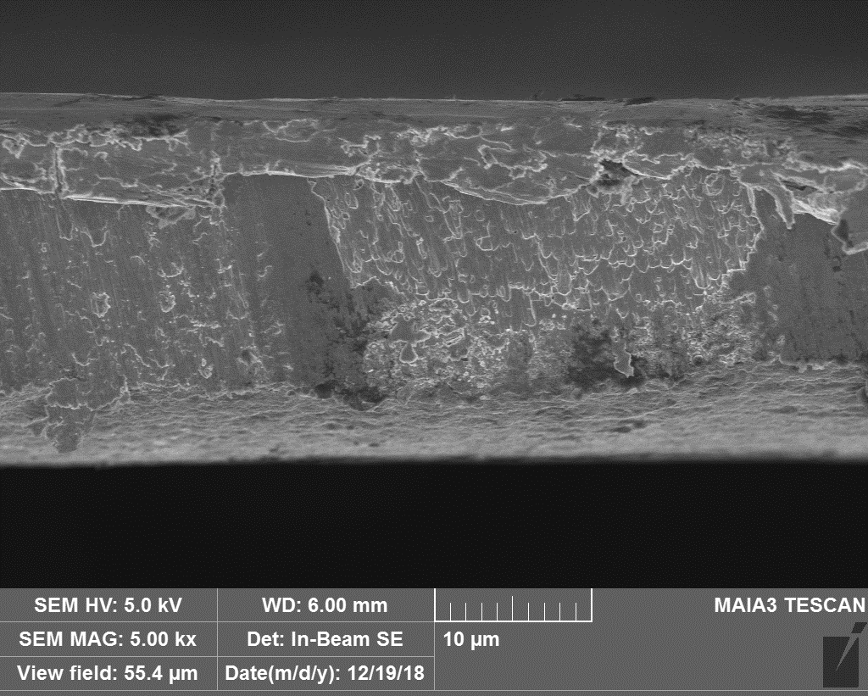
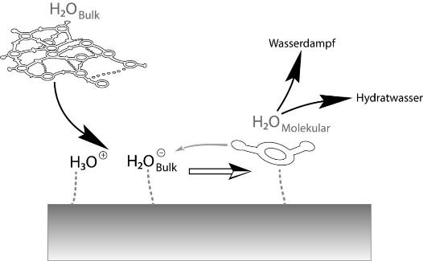
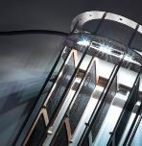
WATER – What is the MOL-catalyst?
The MOL-catalyst is a mineral metal compound
With thanks to Professor Dr. Su Benshueng
Engineering Research Institute
Beijing University of Chemical Technology
A catalyst for providing OH⁻ much more faster AND merging with H⁺ ….without destroying itself

Slide 25
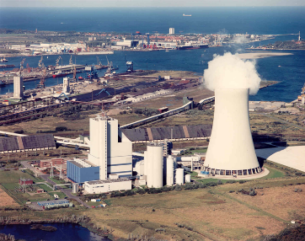
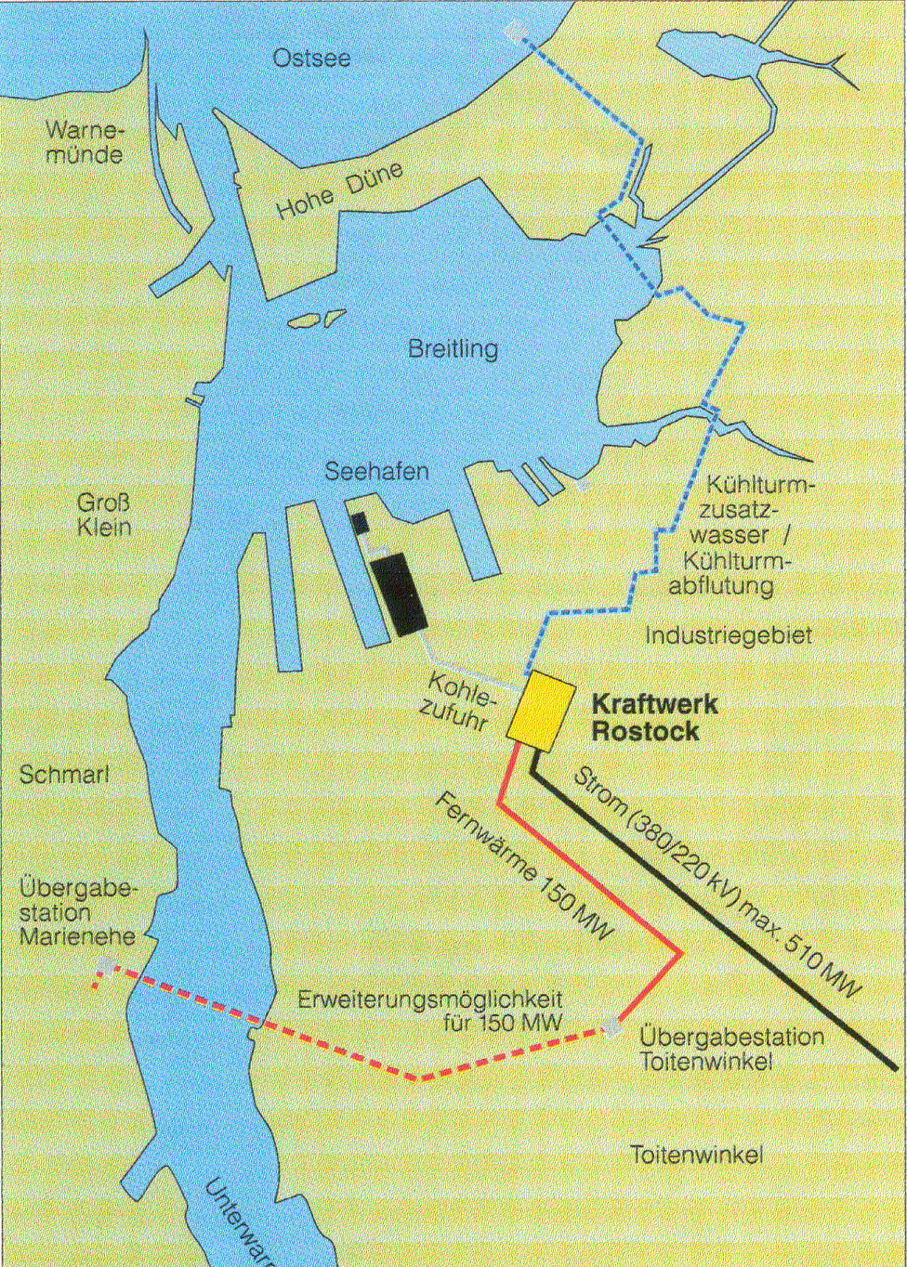
Water Supply – How to handle Challenges
Customers Problem
Deposits
@ make-up water supply
Problems Reason: too much BHP (pump energy)
➔ Partial destruction of hydrate shells

